Slide 1
KWAME NKRUMAH UNIVERSITY OF SCIENCE AND TECHNOLOGY, KUMASI
  MME 386
Dr. Elvis Twumasi

Slide 2
Ship Steering System
Welcome aboard!
The steering gear is responsible for moving the rudder. These systems allow for precise control over the movement of the rudder, which is essential for safe navigation.

Slide 3
Ship Steering System
The rudder is the most visible component of the steering system, as it is the part that actually turns the ship. It is attached to the stern of the ship and can be moved left or right using the steering gear.
The steering gear system generates a torsional force at a certain scale which is then, in turn, is transmitted to the rudder stock that turns the rudder.

Slide 4
Rules for Ship Steering System
As per standard requirements, the steering gear should be capable of steering the ship from 35 degrees port to 35 degrees starboard and vice-versa with the vessel plying forwards at a steady head-on speed for maximum continuous rated shaft rpm.
The major power units and the control systems are to be duplicated so that if one of them fails, the other can easily substitute for them as standby
The steering gear system is to be provided with an additional power unit connected to the emergency power supply from the Emergency Generator

Slide 5
Types of Steering Systems
There types of steering systems used in ships:
  1. Mechanical steering systems
  2. Hydraulic steering systems
  2. Electro-hydraulic steering systems
  4. All Electric Steering System
Initially Mechanical steering systems that used cables to connect the helm to the rudder were used. The mechanical system was simple and reliable but required more effort to steer the ship so it has been replaced with hydraulic and electro-hydraulic systems and electric systems
Hydraulic systems use fluid pressure to move the rudder. Hydraulic systems are smoother and easier to operate, but can be more complex and expensive.

Slide 6
Types of Steering Systems
Electro-hydraulic steering systems is a hybrid system that use motors and hydraulic valves or pumps to turn the rudder. Electric systems are becoming more popular due to their ease of use and precise control.
The All Electric Steering System employs electric motors to control the ship's rudder. The helmsman's input is translated into electrical signals, which drive the electric motor connected to the rudder stock.
Electric systems offer precise control and ease of operation, making them popular on many contemporary ships.

Slide 7
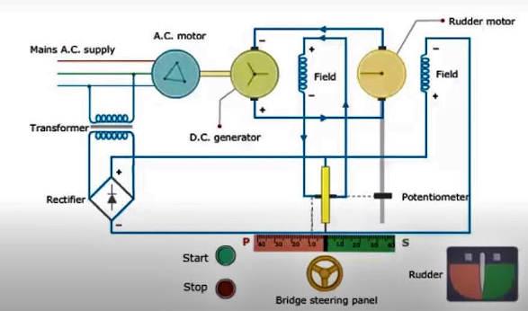
All Electric Steering System
Ward Leonard Ship Steering Control System

Slide 8
Ward Leonard Ship Steering Control System
The rudder of the steering gear system is driven by a DC motor.
The power for the rudder motor is supplied by a DC generator for controllable, output voltage.
The DC generator is driven by a single-speed, three-phase squirrel cage induction motor.
The speed and direction of the rudder motor are varied by varying the applied voltage.

Slide 9
Ward Leonard Ship Steering Control System
The alternating current from the main power source is transformed to lower voltage and rectified to supply the motor field poles.
The output of the generator is varied by varying the generator field current and direction using two rheostat.
The two rheostat contacts, namely
    wheel order rheostat contact and
    the rudder contact
And they are connected to the two ends of the generator field coil.

Slide 10
Ward Leonard Ship Steering Control System
When the steering wheel is in midship position, the two rheostat contacts are in the same position, and no current flows between them.
Now, the steering wheel is turned to port. This causes the wheel order rheostat contact to move up, from the centre position.
Due to the difference in voltages between the two contacts, the current will flow through the generator field coil.
The generator develops power and supplies it to the dc motor, which turns the rudder to the port side.
As the rudder turns, the rudder rheostat contact moves up, and as the rudder reaches the required angle, the rudder contact will reach the wheel order contact position.

Slide 11
Ward Leonard Ship Steering Control System
The current flow to the generator field coil will stop and the Rudder motor will also stop turning the rudder
The same process continues for the star board side.

Slide 12
Ship Navigation Light
The Navigation lights are an essential component of any ship's safety equipment.
The power source for the navigation lights typically comes from the ship's electrical system, which must be designed to provide adequate power to the lights while also maintaining other essential systems.
For example, red and green sidelights indicate the port and starboard sides of a vessel, respectively, while a white stern light indicates the rear of the vessel.

Slide 13
Purpose of Ship Navigation Light
They serve as a means of communication between vessels
They provide critical information about a ship's position, direction, and status.
They help determine a ship's course and avoid potential collisions.
Navigation lights also play a crucial role in ensuring safe navigation through narrow channels, around obstacles, and in poor visibility conditions.

Slide 14
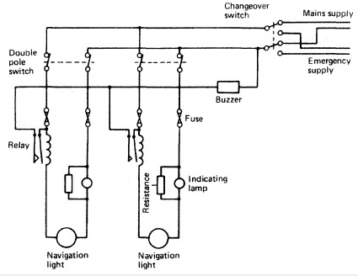
Navigational Light Circuit for Ships

Slide 15
Navigational Light Circuit for Ships
Switchboard: The switchboard is to distribute the generated electricity to the navigation light. Two sources of supply are available from the changeover switch to ensure continuity of supply. The alternate supply is an emergency supply.
Double Pole Switch: A double pole switch connects the supply to each light circuit, with a fuse in each line
Relay: The relay in the circuit operate the buzzer if an open circuit occurs since the relay will de-energize and the trip bar will complete the buzzer circuit.

Slide 16
Navigational Light Circuit for Ships
Resistor across indicating light: The resistance in series with the indicating lamp will ensure the navigation lights operate even if the indicating lamp fails.
A main supply failure will result in all the indicating lamps extinguishing but the buzzer will not sound. The changeover switch will then have to be moved to the alternative supply.
All the navigation lights on ships are installed in pairs, i.e. two in numbers. If one fails, the other one replaces it.

Slide 17
Maintenance of Ship Navigation lights
Prepare the work permit
Put the lock-out tag and inform the officer who is on duty
Try to do the routine maintenance when the ship is in the port
Before climbing up the main mast, take the working permit
Switch off the radars and take out the fuses
Disable the power supply of the nearby ship whistle
Switch off any other communication devices as the antennas, which are usually located near the mast, generate radiations harmful for humans
While working on navigation lights at sea, check the wind flow meter for wind speed and direction. If the wind is heavy avoid climbing on the mast
Check for rolling and pitching of the ship. If it’s too much, don’t climb the mast

Slide 18
Types Navigation Lights
Masthead Light
The masthead light is the white light located up the mast. This light is required when using motor power at night.
Port Sidelight
These lights located on the port side of the watercraft are red and mounted so that boats can see as they approach either head-on or from the left. This light helps tell if a ship is coming towards you or if it is pointing away. The phrase “red, right, returning” means that if you see a ship with its red navigation light on the right, they are facing your ship. The only time it is not needed is when the ship is anchored for the night.

Slide 19
Types Navigation Lights
Starboard Sidelight
If you are to approach a ship from the front or right, you will see the green starboard sidelight. This light helps tell you whether or not you have the right of way.
Sternlight
The rear vessel light is called the stern light. It is used to mark the rear of the ship. The operator can infer from only setting a ship stern light, that they are directly behind the vessel.

Slide 20
Types Navigation Lights
All-Around Light
One of the night lights is the all-around light. This light is intended to be seen from any point and helps to tell what direction a ship is moving. This light is also used when a ship is anchored.
Law Enforcement Light
Lights used by law enforcement on the water are flashing blue lights that can flash 120 times per minute or more.
This light may be displayed by any type of local law enforcement that is engaged in the course of their duty.

Slide 21
Types of Alarms used on ships
There are the different types of emergency alarms or signal onboard ship that is installed to give audio-visual warnings:
General Alarm:
  The general emergency alarm on the ship is recognized by 7 short ringings of the bell followed by a long ring
  The general alarm is sounded to make the crew aware that an emergency has occurred, such as fire, collision, or a scenario that can lead to abandoning the ship

Slide 22
Types of Alarms used on ships
Fire Alarm
The ship’s fire alarm signal is sounded as the continuous ringing of the ship’s electrical bell or the continuous sounding of the ship’s horn.
Man Overboard Alarm:
  There have been many situations when a crew working on the ship-side or a passenger in a cruise ship fell in the water at high seas.
  When a man falls overboard, the man overboard alarm sound signal is activated on the ship.
  The MOB alarm signal comprises the vessel’s internal alarm bell for 3 long rings to notify the crew onboard, along with 3 long blasts on the ship whistle to inform the other ships in the nearby vicinity.

Slide 23
Types of Alarms used on ships
Navigational Alarm:
  In the navigation bridge, most of the navigational equipment and navigation lights are fitted with failure alarms.
  If any of these malfunctions, a ship alarm signal on the bridge will be sounded whose details (location, equipment affected, type of problem etc.) will be displayed on the notification screen provided on the bridge navigation panel.
Machinery Space Alarm and Cargo Space CO2 Alarm
Ship Security Alarm System (SSAS)
When the SSAS is activated, no alarm is sounded on board the ship nor alerts other vessels in the vicinity. Instead, this signal notifies different coastal authorities or competent authorities whose proximity to the ship is presently operating via a global satellite system to inform about the piracy.

